Slide 1

Data Structures and Algorithms Instructor: Maira Sami
maira.sami@szabist.edu.pk
Campus 100
Room No. 101

Slide 2
Linked Lists

Slide 3
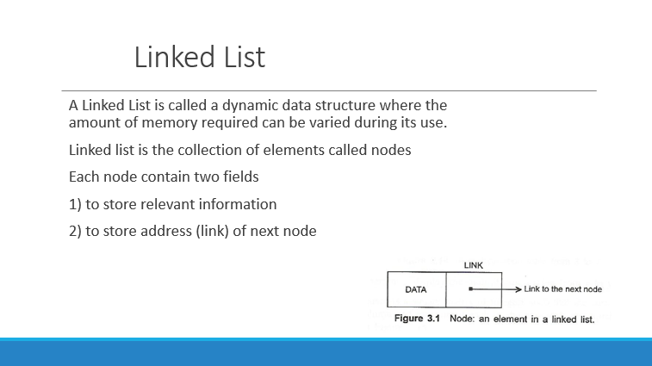

Slide 4
Definition
A Linked List is an ordered collection of finite, homogenous data elements called ‘nodes’.
The linear order is maintained by means of links or pointers.
A Linked List can be classified into three major groups:
1) Single Linked List
2) Circular Linked List
3) Double Linked List

Slide 5
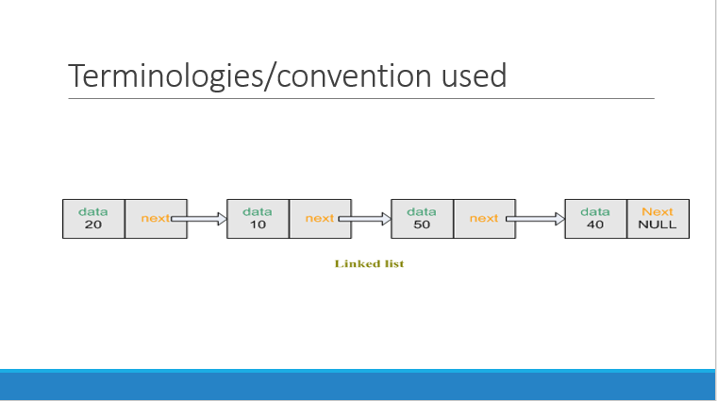

Slide 6
Head
Predecessor of X
Node X
Success-or of X
tail
For each node the node that is in front of it is called predecessor.
The node that is after it is called successor.

Slide 7
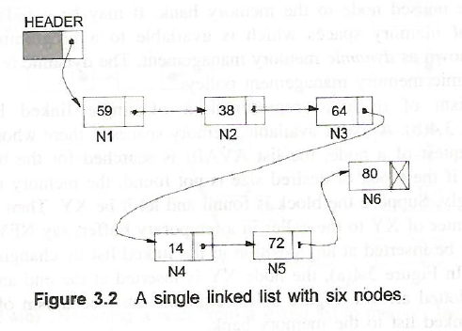
In a single linked list each node contains only one link which points to the following node in the list.
Figure shows a linked list with six nodes.
HEADER is an empty node and is only used to store a pointer to the first node N1.
Thus starting from the HEADER node one can reach the last node whose link field has a null value.
A single linked list is also called a one way list as it can be traversed only from left to right.

Slide 8
Singly-linked lists
Here is a singly-linked list (SLL):
myList
a
b
c
d
Each node contains a value and a link to its successor (the last node has no successor)
The header points to the first node in the list (or contains the null link if the list is empty)

Slide 9
Characteristics
Insert and delete nodes in any order
The nodes are connected
Each node has two components
Information (data)
Link to the next node
The nodes are accessed through the links between them

Slide 10
Terminology
Head (front, first node):
The node without predecessor, the node that starts the lists.
Tail (end, last node):
The node that has no successor, the last node in the list.
Current node: The node being processed.
From the current node we can access the next node.
Empty list: No nodes exist

Slide 11
Linked list operations
Traverse
Insert
Delete

Slide 12
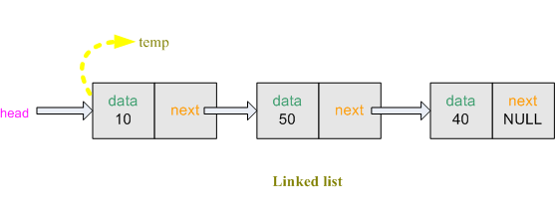
Traversing in link list
while( temp1!=NULL )
{
cout<< temp1->data<<" "; // show the data in the linked list
temp1 = temp1->next; // transfer the address of 'temp->next' to 'temp'
}
Notes:
We create node *temp1. Transfer the address of *head to *temp1. So *temp1 is also pointed at the front of the linked list. Linked list has 3 nodes.
We can get the data from first node using temp1->data. To get data from second node, we shift *temp1 to the second node. Now we can get the data from second node.

Slide 13
Algorithm
Suppose START is the address of the first node in the linked list. Following algorithm will visit all nodes from the START node to the end.
If (START is equal to NULL)
(a) Display “The list is Empty”
(b) Exit
Initialize TEMP = START
Repeat the step 4 and 5 until (TEMP → Next == NULL )
Display “TEMP → DATA”
TEMP = TEMP → Next
Exit

Slide 14
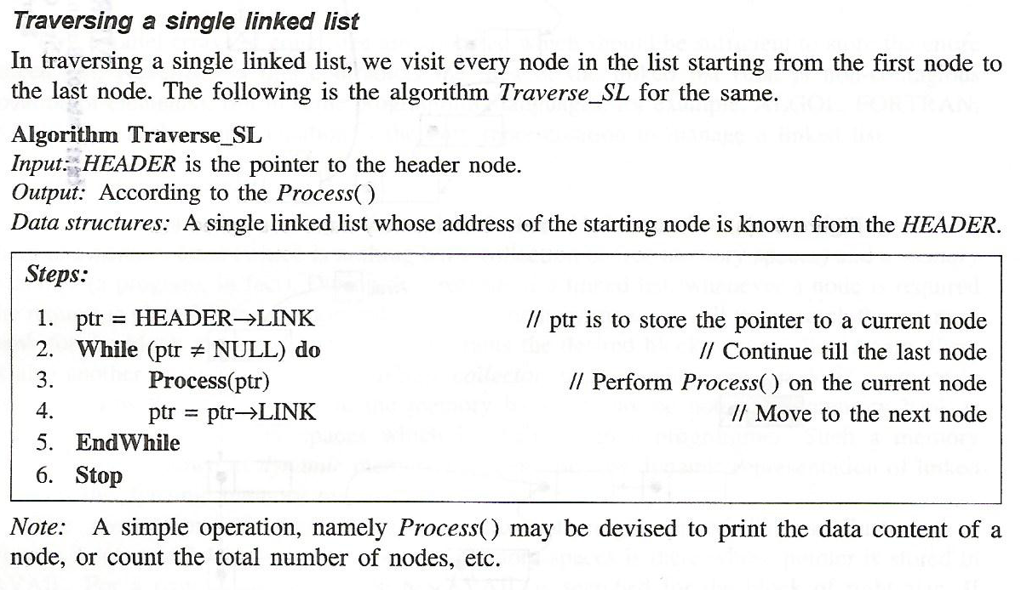

Slide 15
ALGORITHM FOR SEARCHING A NODE
Suppose START is the address of the first node in the linked list and DATA is the information to be searched. After searching, if the DATA is found, POS will contain the corresponding position in the list.
Input the DATA to be searched
Initialize TEMP = START; POS =1;
Repeat the step 4, 5 and 6 until (TEMP is equal to NULL)
If (TEMP → DATA is equal to DATA)
(a) Display “The data is found at POS”
(b) Exit
TEMP = TEMP → Next
POS = POS+1
If (TEMP is equal to NULL)
(a) Display “The data is not found in the list”
Exit
Notes:
Assignment

Slide 16
Insertion in link list
01- Insert as the new first node
02- Insert as the new last node
03- Insert after specified number of nodes

Slide 17
01- Insert as the new first node
Steps:
Create a Node
Set the node data Values
Connect the pointers

Slide 18
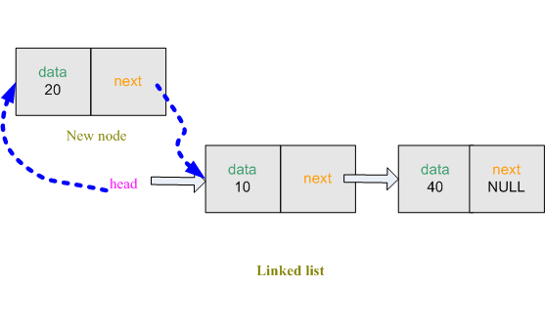
01- Insert as the new first node
Notes:
Then we take the data input from the user and store in the node info variable. Create a temporary node node *temp and allocate space for it.
-Then place info to temp->data. So the first field of the node *temp is filled. Now temp->next must become a part of the remaining linked list (although now linked list is empty but imagine that we have a 2 node linked list and head is pointed at the front) So temp->next must copy the address of the *head (Because we want Delete at first) and we also want that *head will always point at front. So *head must copy the address of the node *temp.

Slide 19
Algorithm
Insert a Node at the beginning
Input DATA to be inserted
Create a NewNode
NewNode → DATA = DATA
If (START equal to NULL)
(a) NewNode → Link = NULL
5. Else
(a) NewNode → Link = START
6. START = NewNode
7. Exit

Slide 20
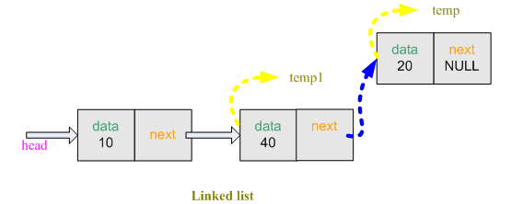
Insert node at the end

Slide 21
Algorithm
Insert a Node at the end
Input DATA to be inserted
Create a NewNode
NewNode → DATA = DATA
NewNode → Next = NULL
If (SATRT equal to NULL)
(a) START = NewNode
Else
(a) TEMP = START
(b) While (TEMP → Next != NULL)
(i) TEMP = TEMP → Next
TEMP → Next = NewNode
Exit

Slide 22
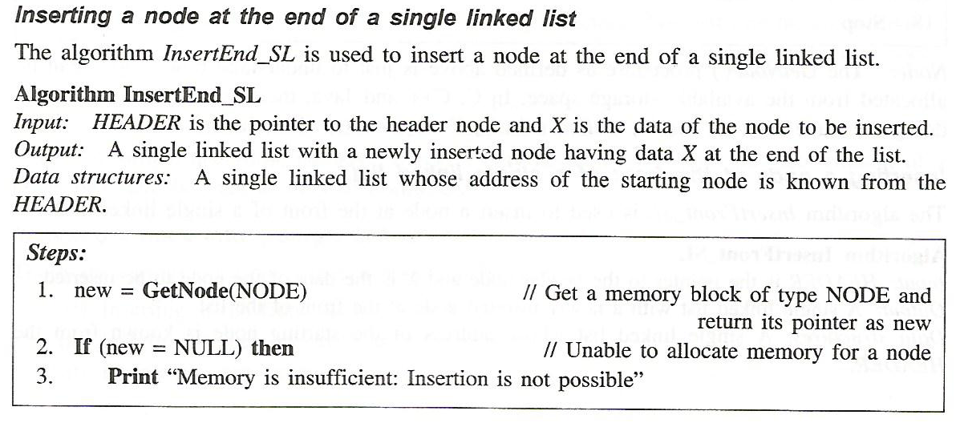
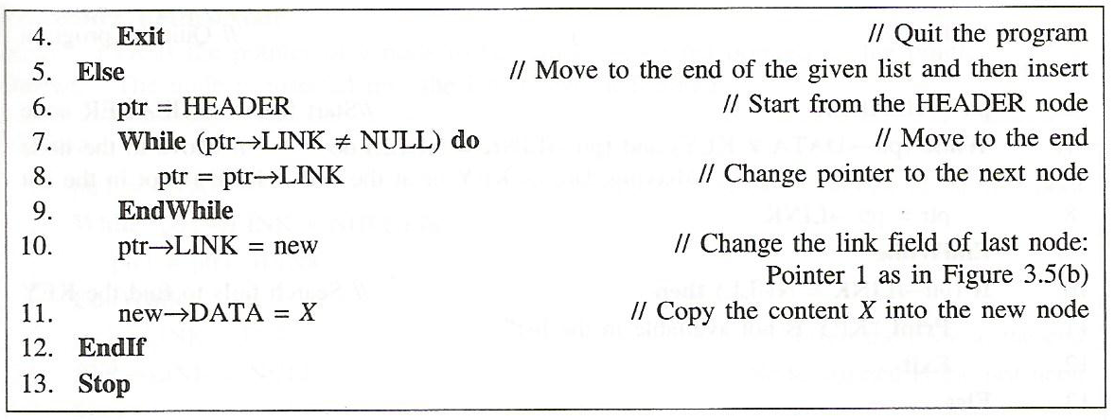

Slide 23
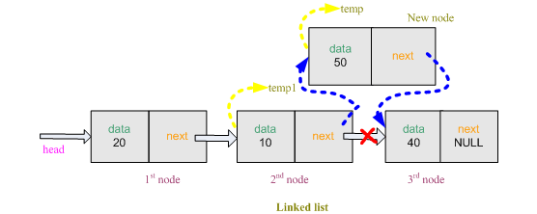
03- Insert after specified number of nodes

Slide 24
Algorithm
Insert a Node at any specified position
Create a New Node
NewNode → DATA = DATA
NewNode → Next = TEMP → Next
TEMP → Next = NewNode
Exit

Slide 25
01- Delete from front
Steps
Break the pointer connection
Re-connect the nodes
Delete the node

Slide 26
01- Delete from front
temp = head; // transfer the address of 'head' to 'temp‘
head = temp->next; // transfer the address of 'temp->next‘ to 'head‘
free(temp);

Slide 27
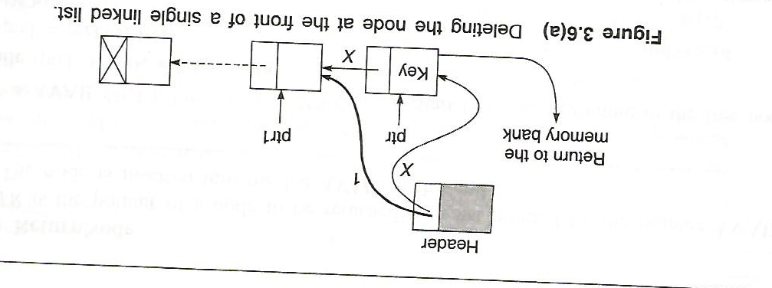

Slide 28
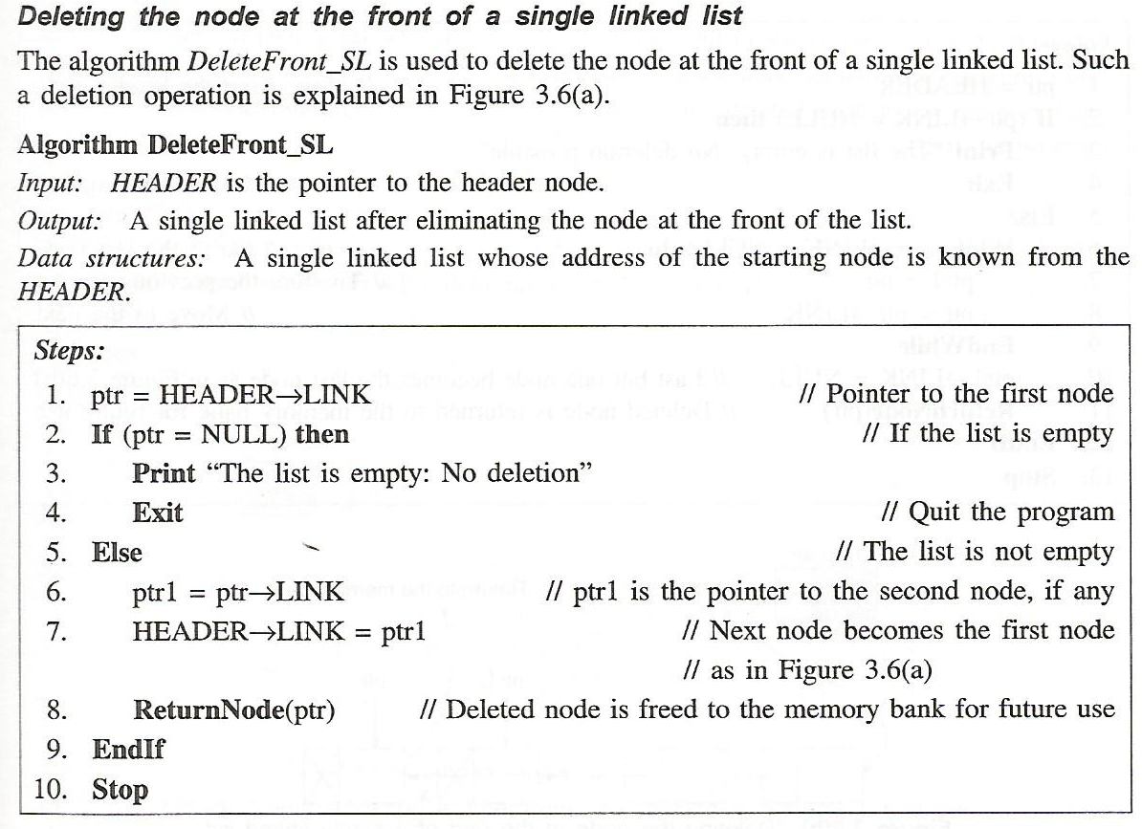

Slide 29
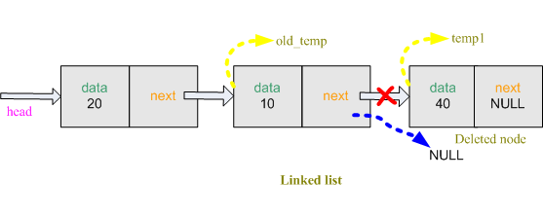
02- Delete from back

Slide 30
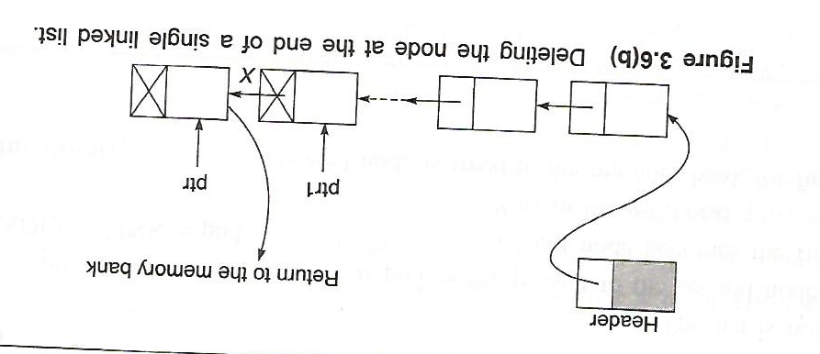

Slide 31
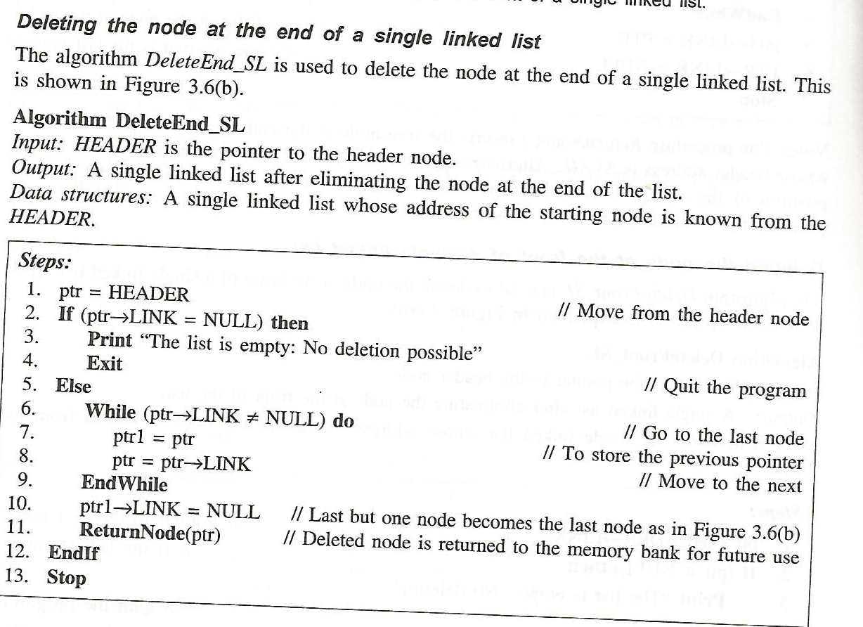

Slide 32
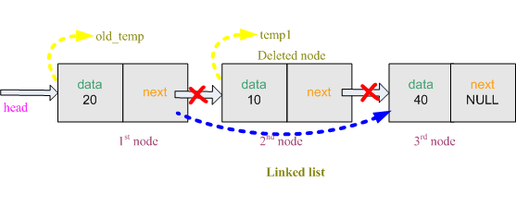
03- Delete specified number of node

Slide 33
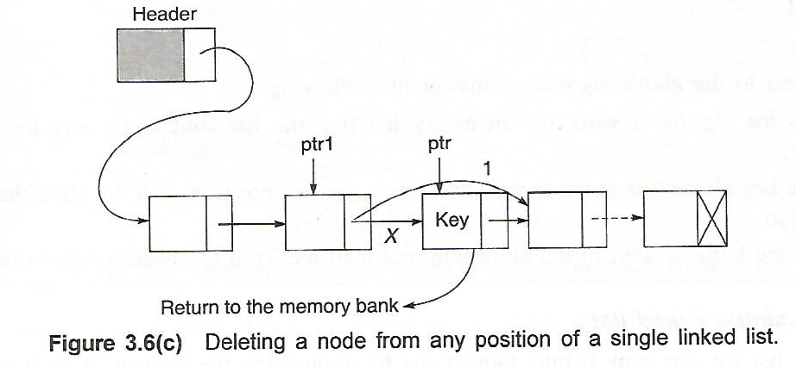

Slide 34
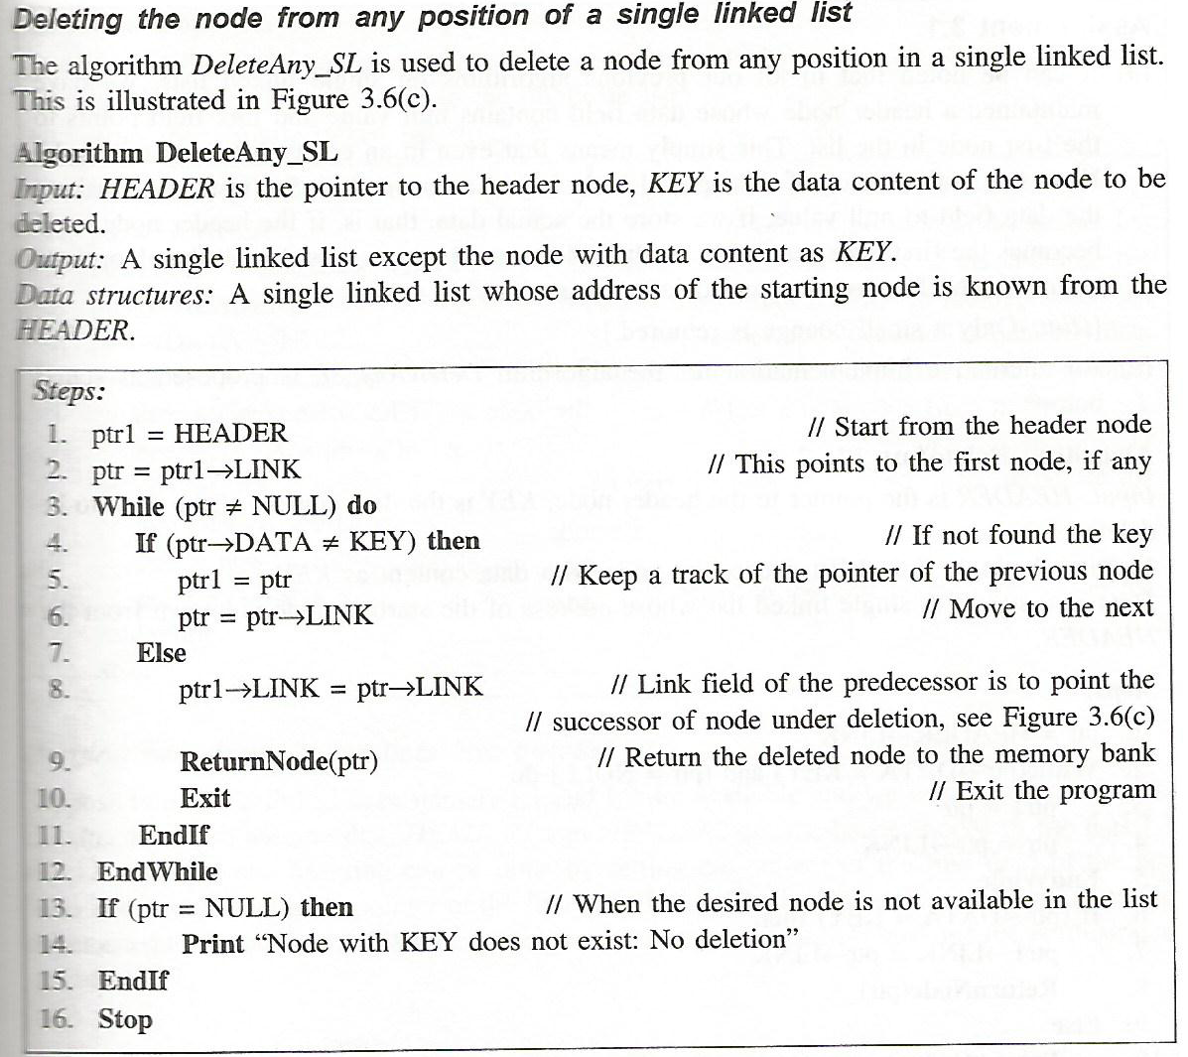

Slide 35
node *temp1; // create a temporary node
temp1 = (node*)malloc(sizeof(node)); // allocate space for node
temp1 = head; // transfer the address of 'head' to 'temp1'
node *old_temp; // create a temporary node
old_temp = (node*)malloc(sizeof(node)); // allocate space for node
old_temp = temp1; // transfer the address of 'temp1' to 'old_temp‘
cout<<"ENTER THE NODE NUMBER:";
cin>>node_number; // take location
for( int i = 1 ; i < node_number ; i++ )
{
old_temp = temp1; // store previous node
temp1 = temp1->next; // store current node
}
old_temp->next = temp1->next; // transfer the address of 'temp1->next' to 'old_temp->next‘
free(temp1);

Slide 36
Doubly-linked lists
prev
next
Here is a doubly-linked list (DLL):
elem
node
header
nodes/positions
trailer
elements
Each node contains a value, a link to its successor (if any), and a link to its predecessor (if any)
The header points to the first node in the list and to the last node in the list (or contains null links if the list is empty)

Slide 37
Doubly Linked Lists
pHead
a
b
c
Advantages:
Convenient to traverse the list backwards.
Simplifies insertion and deletion because you no longer have to refer to the previous node.
Disadvantage:
Increase in space requirements.

Slide 38
Insertion
head
current
newNode = new Node(x);
newNode->prev = current;
newNode->next = current->next;
newNode->prev->next = newNode;
newNode->next->prev = newNode;
current = newNode;
newNode

Slide 39
Insertion
We visualize operation insertAfter(p, X), which returns position q
p
A
B
C
p
A
B
q
C
X
p
q
A
B
X
C

Slide 40
ALGORITHM FOR INSERTING A NODE
Suppose START is the first position in linked list. Let DATA be the element to be
inserted in the new node. POS is the position where the NewNode is to be inserted. TEMP
is a temporary pointer to hold the node address.
Input the DATA and POS
Initialize TEMP = START; i = 0
Repeat the step 4 if (i less than POS) and (TEMP is not equal to NULL)
TEMP = TEMP → RPoint; i = i +1
If (TEMP not equal to NULL) and (i equal to POS)
(a) Create a New Node
(b) NewNode → DATA = DATA
(c) NewNode → RPoint = TEMP → RPoint
(d) NewNode → LPoint = TEMP
(e) (TEMP → RPoint) → LPoint = NewNode
(f ) TEMP → RPoint = New Node
Else
(a) Display “Position NOT found”
7. Exit

Slide 41
Deletion
We visualize remove(p), where p == last()
p
A
B
C
D
A
B
C
p
D
A
B
C

Slide 42
Deletion
head
current
oldNode = current;
oldNode->prev->next = oldNode->next;
oldNode->next->prev = oldNode->prev;
delete oldNode;
current = head;

Slide 43
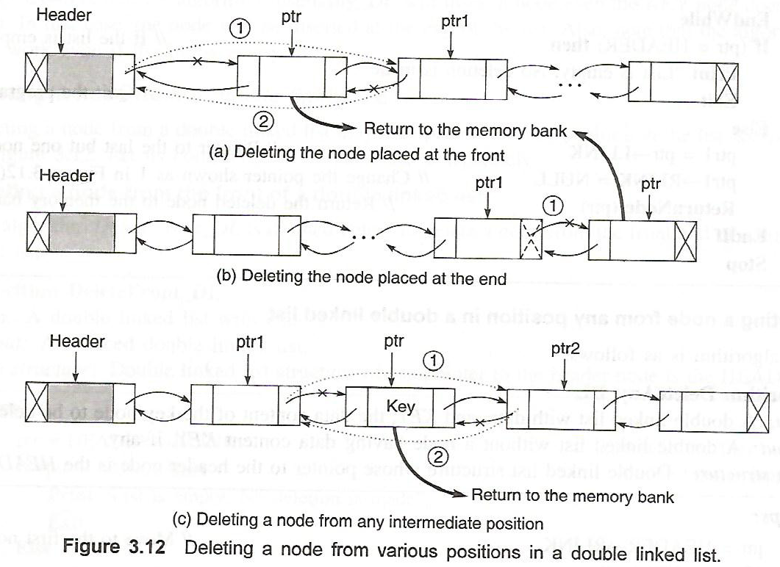

Slide 44
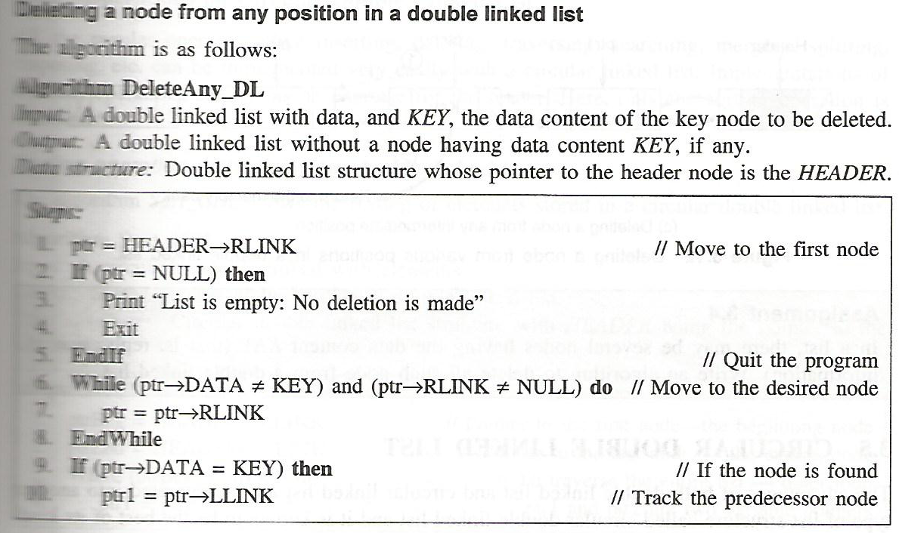
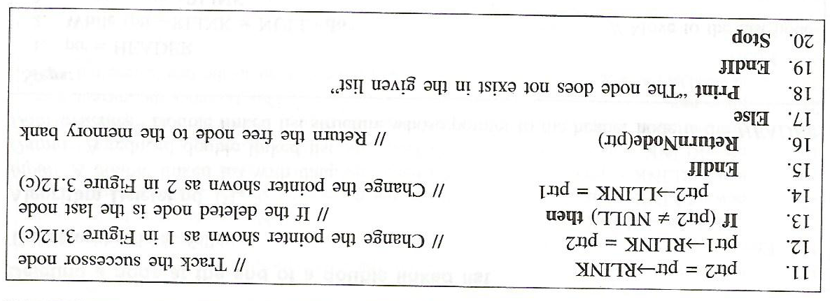

Slide 45
ALGORITHM FOR DELETING A NODE
Suppose START is the address of the first node in the linked list. Let POS is the position of the node to be deleted. TEMP is the temporary pointer to hold the address of the node. After deletion, DATA will contain the information on the deleted node.
Input the POS
Initialize TEMP = START; i = 0
Repeat the step 4 if (i less than POS) and (TEMP is not equal to NULL)
TEMP = TEMP → RPoint; i = i +1
If (TEMP not equal to NULL) and (i equal to POS)
(a) Create a New Node
(b) NewNode → DATA = DATA
(c) NewNode → RPoint = TEMP → RPoint
(d) NewNode → LPoint = TEMP
(e) (TEMP → RPoint) → LPoint = NewNode
(f ) TEMP → RPoint = New Node
6. Else
(a) Display “Position NOT found”
7. Exit

Slide 46
DLLs compared to SLLs
Advantages:
Can be traversed in either direction (may be essential for some programs)
Some operations, such as deletion and inserting before a node, become easier
Disadvantages:
Requires more space
List manipulations are slower (because more links must be changed)
Greater chance of having bugs (because more links must be manipulated)
Random access is time consuming

